Slide 1
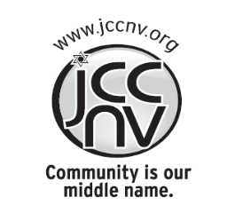
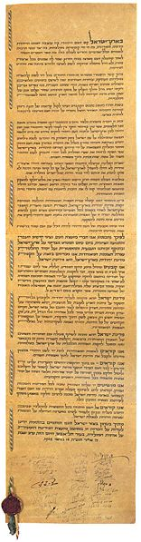
Declaration of Independence of Israel
The Declaration of Independence
(Hebrew: הכרזת העצמאות Hakhrazat HaAtzma'ut)
of Israel, was the official announcement
that a new Jewish state, named the State of Israel
(Medinat Yisrael in Hebrew), had been formally
established in parts of what
was known as the British Mandate for Israel and on land
where, in antiquity, the Kingdoms of Israel, Judah and
Judea had once been. The State of Israel was declared
only on the territories assigned to it "by the Partition
Plan" (the State of Israel would
later be expanded as a result of the
1948 War of Independence).
Shiri Rahamim JCCNV Community Shlica

Slide 2
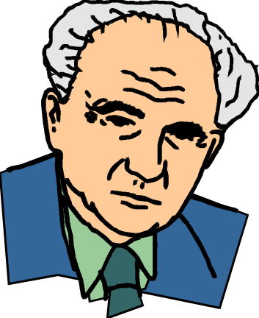
It has been called the start of the "Third Jewish
Commonwealth" by some observers. The "First
Jewish Commonwealth" ended with the destruction of
Solomon's Temple in 586 BCE, the second with the
destruction of the Second Temple in 70 CE, and the
crushing of Bar Kokhba's revolt by the Roman Empire
in the year 135
Shiri Rahamim JCCNV Community Shlica

Slide 3
Context of the Declaration of Independence
The document commences by drawing a direct line from Biblical times to the present:
…the Land of Israel, was the birthplace of the Jewish people. Here their spiritual,
religious and political identity was shaped. Here they first attained to statehood, created
cultural values of national and universal significance and gave to the world the eternal
Book of Books.
It acknowledges the Jewish exile over the millennia, mentioning both ancient "faith"
and new "politics":
After being forcibly exiled from their land, the people kept faith with it throughout their
Dispersion and never ceased to pray and hope for their return to it and for the
restoration in it of their political freedom.
It speaks of the urge of Jews to return to their ancient homeland:
Impelled by this historic and traditional attachment, Jews strove in every successive
generation to re-establish themselves in their ancient homeland. In recent decades they
returned in their masses.
It describes Jewish immigrants to Israel in the following terms:
Pioneers… and defenders, they made deserts bloom, revived the Hebrew language,
built villages and towns, and created a thriving community controlling its own economy
and culture, loving peace but knowing how to defend itself, bringing the blessings of
progress to all the country's inhabitants, and aspiring towards independent nationhood.
Shiri Rahamim JCCNV Community Shlica

Slide 4
In 1897, at the summons of the spiritual father of the Jewish State, Theodore
Herzl, the First Zionist Congress convened and proclaimed the right of the Jewish
people to national rebirth in what it claimed to be its own country. This right was
supported by the British government in the Balfour Declaration of November 2, 1917
and re-affirmed in the Mandate of the League of Nations which, in particular, gave
international sanction to the historic connection between the Jewish people and
Palestine and to the right of the Jewish people to rebuild its National Home.
The European Holocaust of 1939–45 is part of the imperative for the re-
settlement of the homeland:
The catastrophe which recently befell the Jewish people—the massacre of
millions of Jews in Europe—was another clear demonstration of the urgency of
solving the problem of its homelessness by re-establishing in Israel the Jewish
State, which would open the gates of the homeland wide to every Jew and confer
upon the Jewish people the status of a fully privileged member of the community of
nations.
Survivors of the Nazi Holocaust in Europe, as well as Jews from other parts of
the world, continued to migrate to Israel, undaunted by difficulties, restrictions and
dangers, and never ceased to assert their right to a life of dignity, freedom and
honest toil in their national homeland.
Shiri Rahamim JCCNV Community Shlica

Slide 5
On November 29, 1947, the United Nations General Assembly passed a resolution
calling for the establishment of a Jewish State in Israel, requiring the inhabitants of Israel
to take such steps as were necessary on their part for the implementation of that
resolution. This recognition by the United Nations of the right of the Jewish people to
establish their State is irrevocable.
On the issues of sovereignty and self-determination:
This right is the natural right of the Jewish people to be masters of their own fate, like
all other nations, in their own sovereign State.
Thus members and representatives of the Jews of Palestine and of the Zionist
movement upon the end of the British Mandate, by virtue of "natural and historic right"
and based on the United Nations resolution… Hereby declare the establishment of a
Jewish state in the land of Israel to be known as the State of Israel.
…Israel will be open for Jewish immigration and for the "Ingathering of the Exiles"; it
will foster the development of the country for the benefit of all its inhabitants; it will be
based on freedom, justice and peace as envisaged by the prophets of Israel; it will
ensure complete equality of social and political rights to all its inhabitants irrespective of
religion, race or sex; it will guarantee freedom of religion, conscience, language,
education and culture; it will safeguard the Holy Places of all religions; and it will be
faithful to the principles of the Charter of the United Nations.
Shiri Rahamim JCCNV Community Shlica

Slide 6
The new state pledged that it will take steps to bring about the economic
union of the whole of Eretz-Israel and appealed:
in the very midst of the onslaught launched against us now for months
— to the Arab inhabitants of the State of Israel to preserve peace and
participate in the up building of the State on the basis of full and equal
citizenship and due representation in all its provisional and permanent
institutions. We extend our hand to all neighboring states and their peoples
in an offer of peace and good neighborliness, and appeal to them to
establish bonds of cooperation and mutual help with the sovereign Jewish
people settled in its own land. The State of Israel is prepared to do its share
in a common effort for the advancement of the entire Middle East.
A final appeal is made to the Jewish people throughout the Diaspora to
rally round the Jews of Eretz-Israel in the tasks of immigration and up
building and to stand by them in the struggle for the realization of their age-
old dream, the redemption of Israel.
Concluding by "Placing our trust in the Rock of Israel…" (language
which was the result of a compromise between religious and secular
groups) the signatories affixed their signatures.
Shiri Rahamim JCCNV Community Shlica

Slide 7
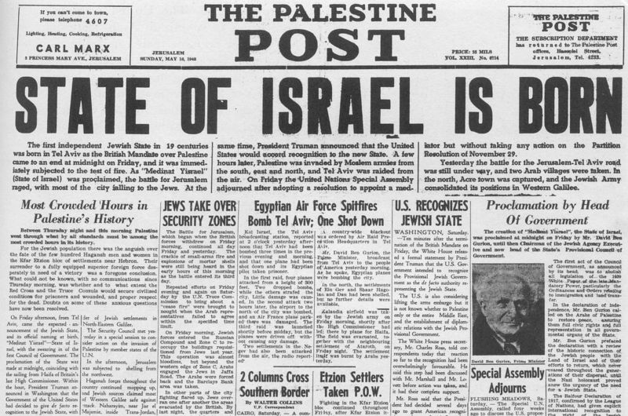
Shiri Rahamim JCCNV Community Shlica

